Slide 1

HINTS SURVEY DATA ANALYSIS
Team DC 20008
DI HU
Harshit Soral
Muhammad Usman
Yao Xiao

Slide 2
Today Agenda
01. Introduction
02. Exploratory Analysis
03. Predictive Analysis
04. Conclusion

Slide 3
Introduction
Happiness is the highest form of health.
-Dalai Lama

Slide 4



Process Overview
Load
Transform
Results
Clean
Analysis
Data Overview
Over 730 variables
Around 5,550 observations
Majority Categorical variables
Data Cleaning
Eliminate Columns with High Missing Values
Clean the variables used earlier for statistical learning
Significant Attributes
SeekingHealthInfo
Depression-Related
Education
Age
GeneralHealth

Slide 5
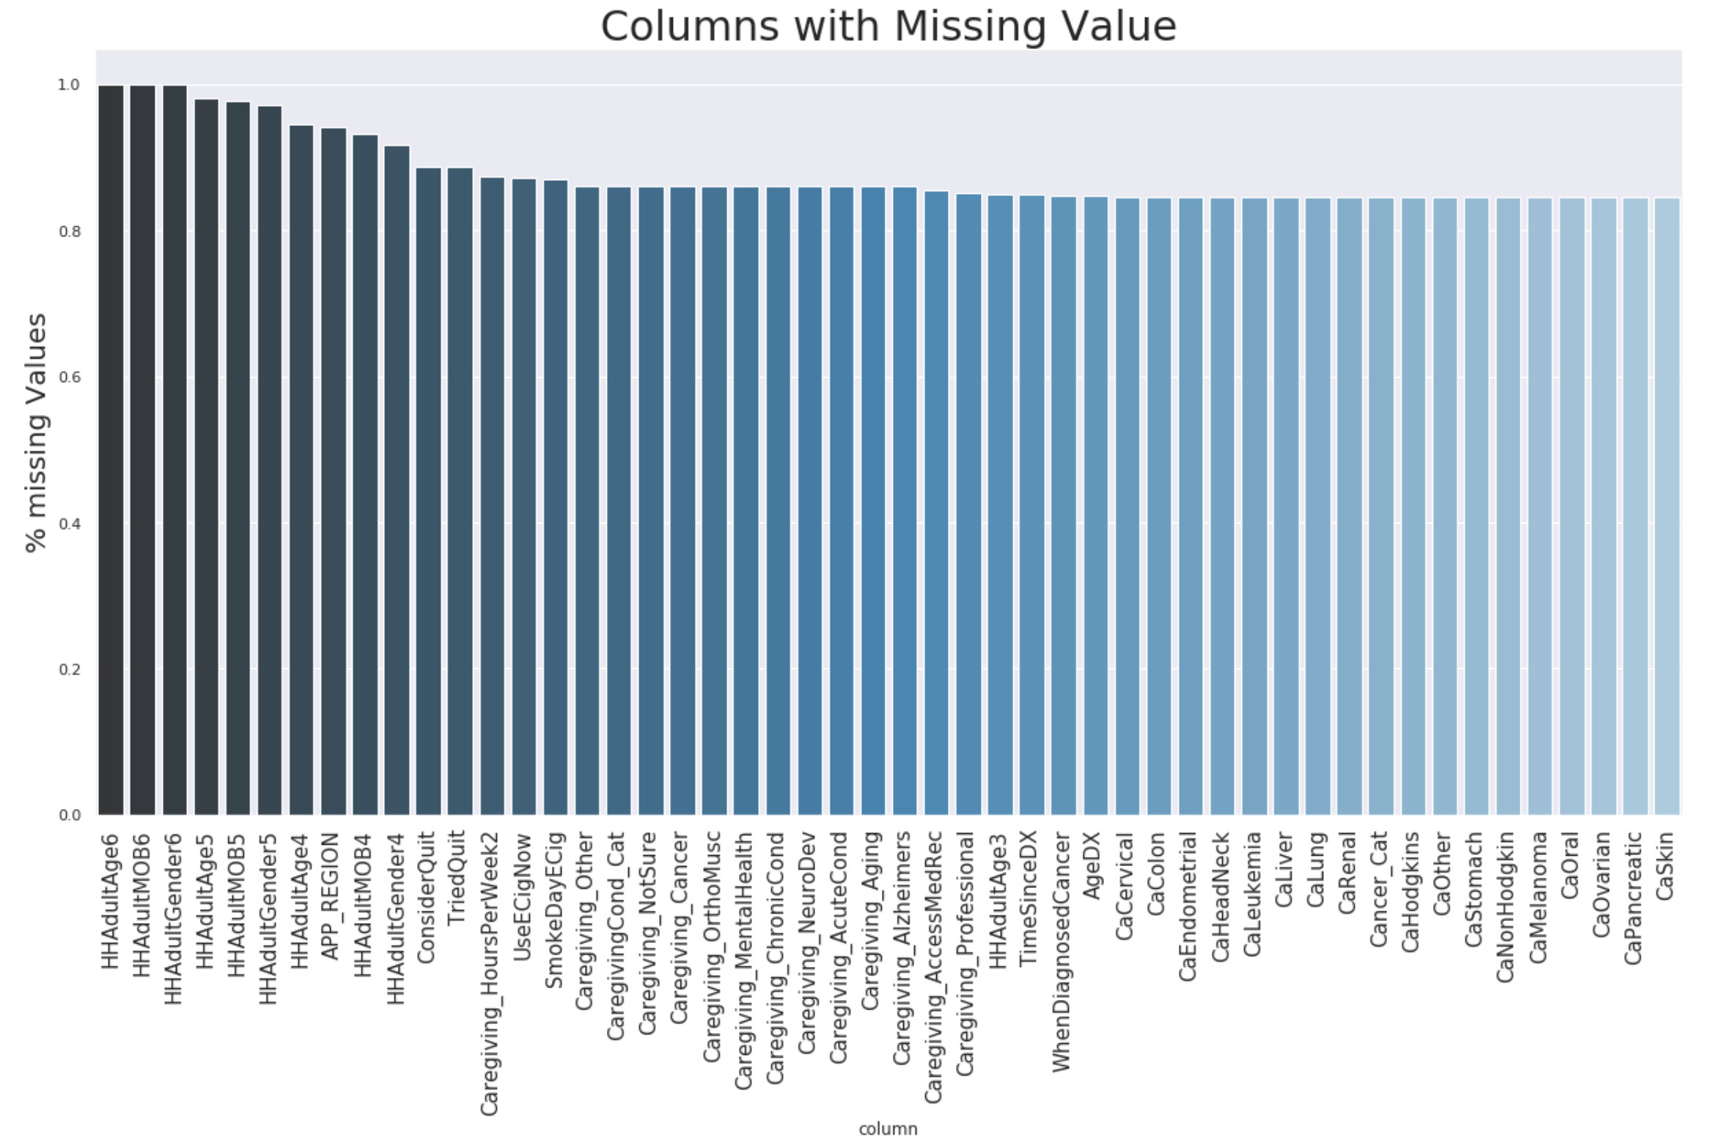

Slide 6
Exploratory Analysis
It is health that is real wealth and not pieces of gold and silver.
-Mahatma Gandhi

Slide 7
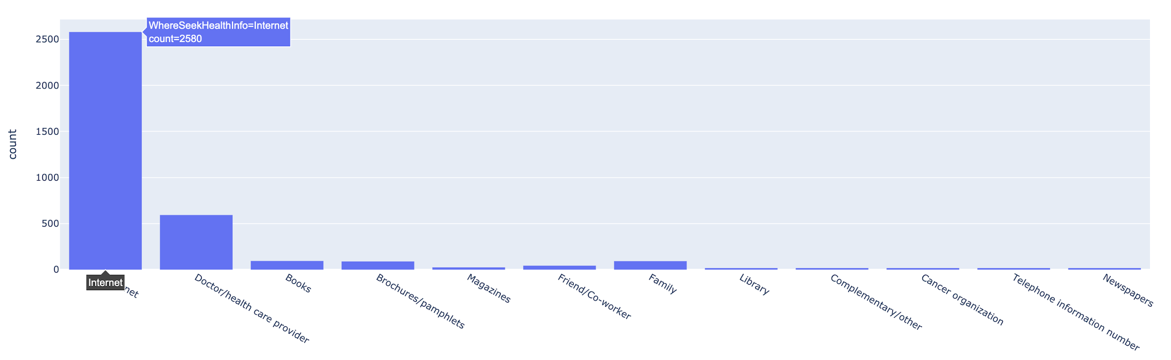
Various Sources of Health Information
Number of Users
Description
A wonderful serenity has taken possession
Description
A wonderful serenity has taken possession
Information Sources
Internet is the most popular way!

Slide 8
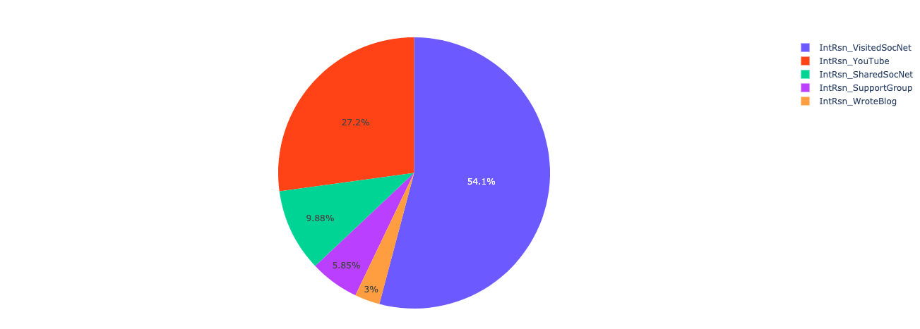
Internet Sources and their popularity
Social media networks like Facebook and Twitter are the most popular followed by YouTube.

Slide 9
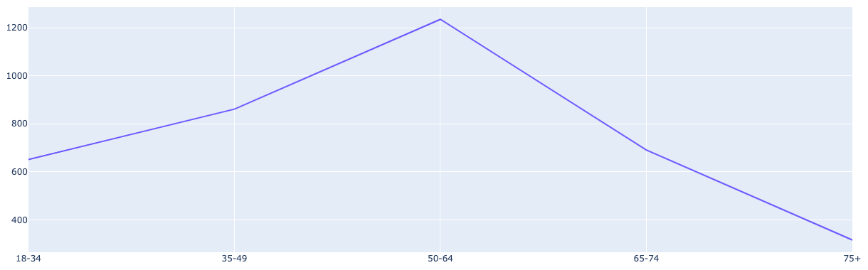
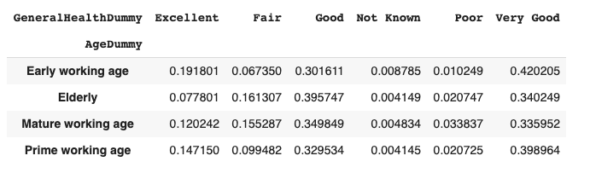
Generation Differences
Number of Users
Age Group
Mid-age people search more!
Youth --- More confident in health?
Elder--- Don’t use Internet much?

Slide 10
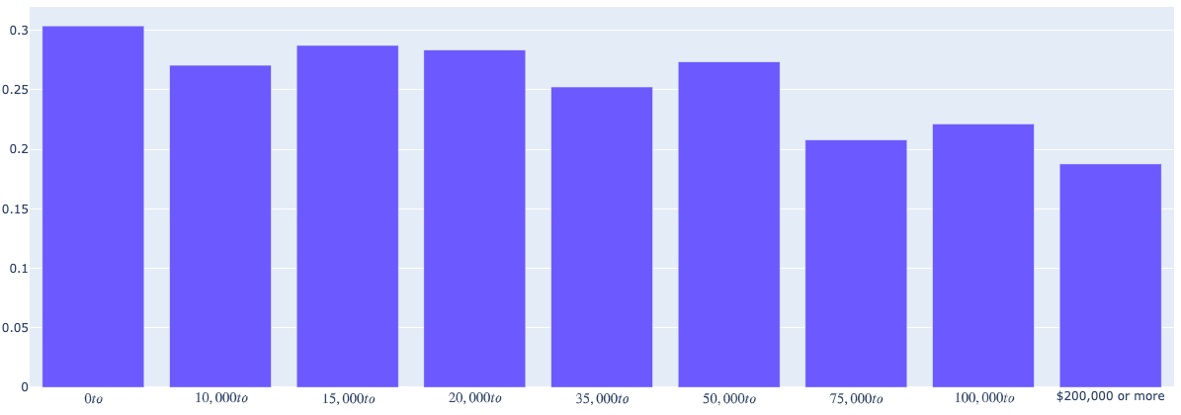
Income Differences
# people avoiding doctors
Income Range
People with higher incomes are less likely to avoid a doctor visit.

Slide 11
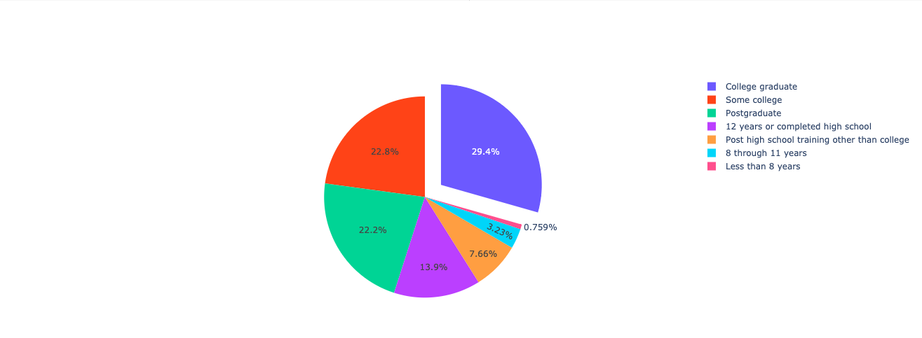
Education level
College graduates are more health conscious, at least more curious about their health information from various sources.

Slide 12
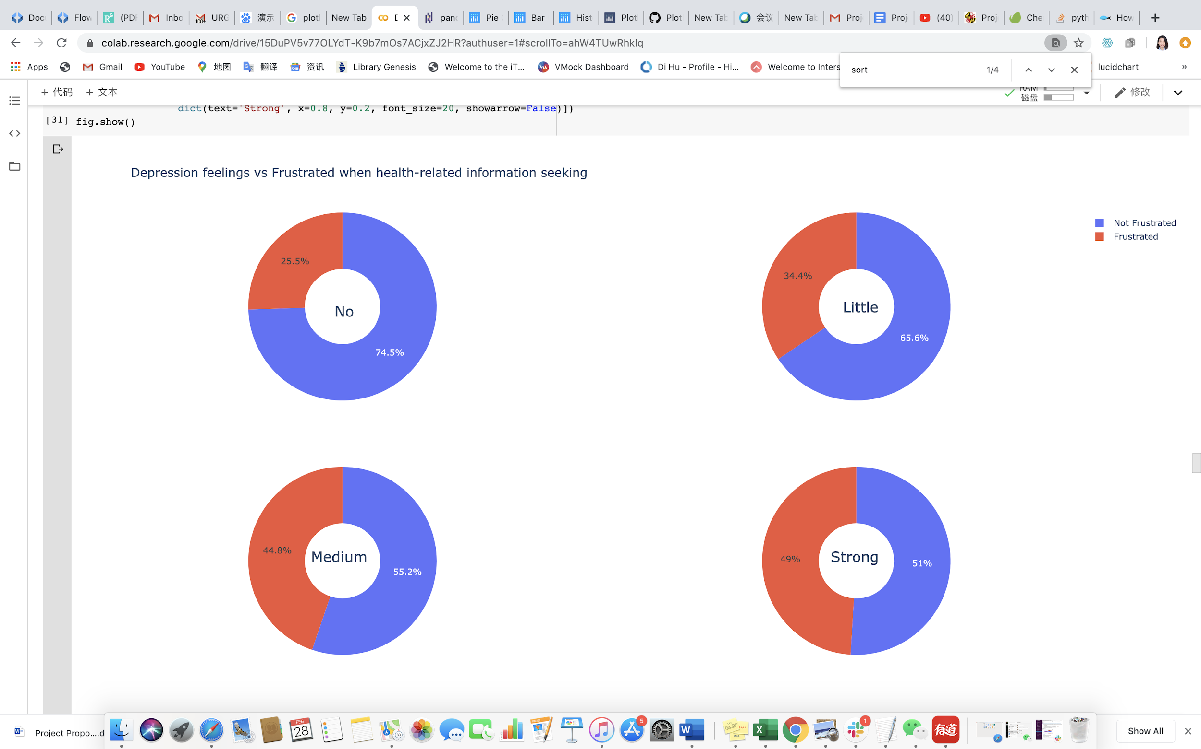
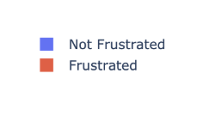
Depression levels vs frustration while seeking health info.
Description
People who feel more depressed tends get frustrated more easily when seeking health-related information!
A wonderful serenity has taken possession
A wonderful serenity has taken possession

Slide 13
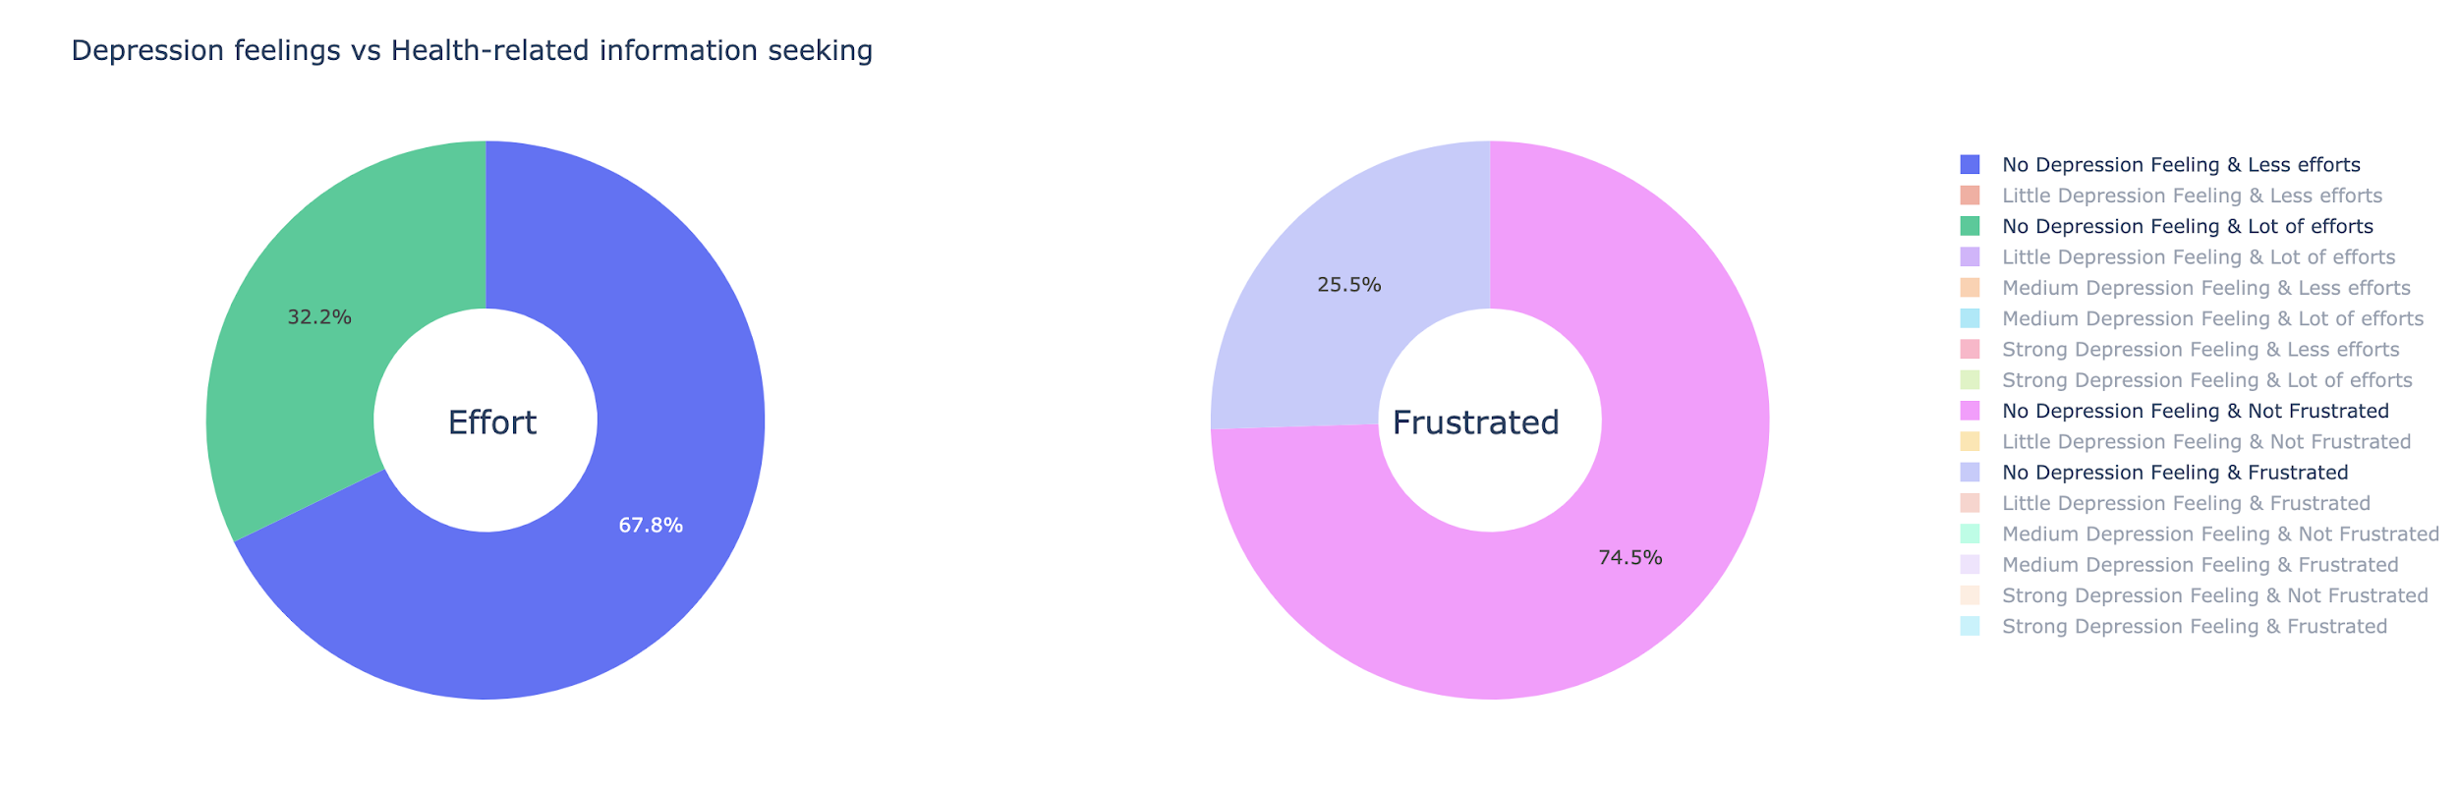
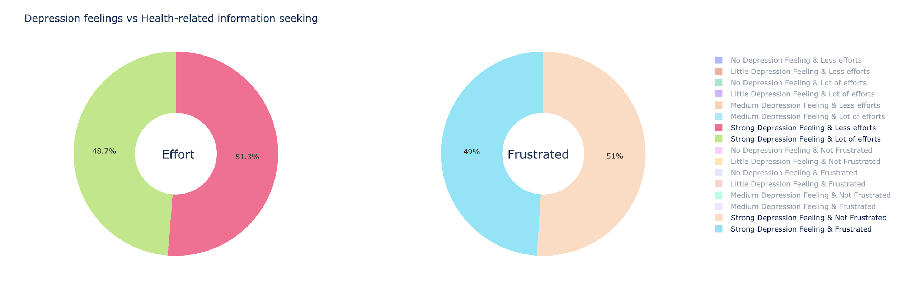
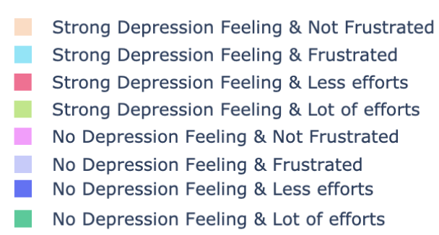
Lot of efforts= Frustrated?
People who don’t feel depressed will not get frustrated even they put a lot of efforts. However, people who feel more depressed will get frustrated even they put less efforts on health information seeking.

Slide 14
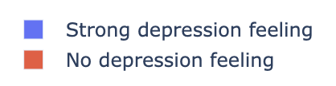
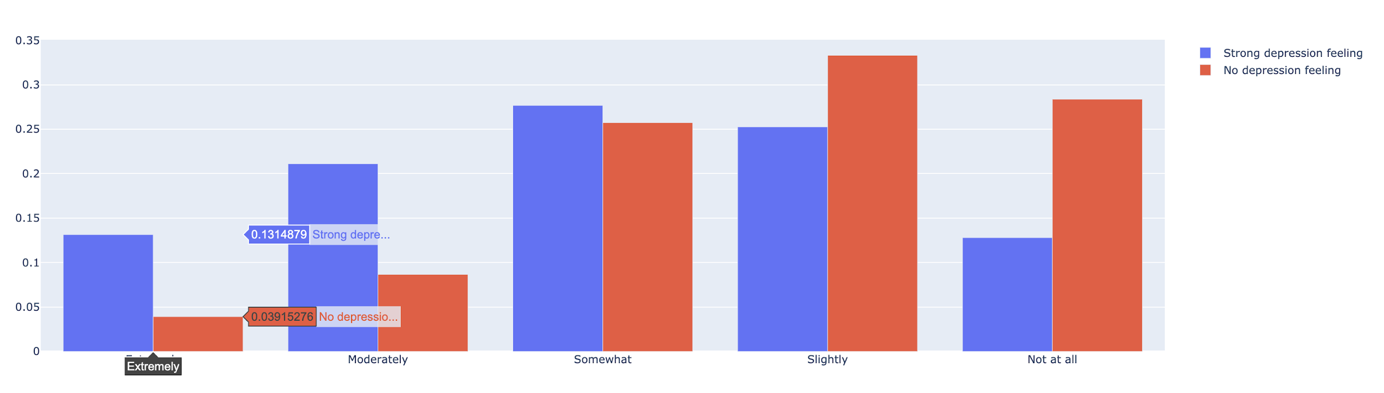
Cancer worries by depression levels
Description
Proportion
A wonderful serenity has taken possession
Description
A wonderful serenity has taken possession
Worried about getting cancer
People who feel more depressed worry more about getting cancer!

Slide 15
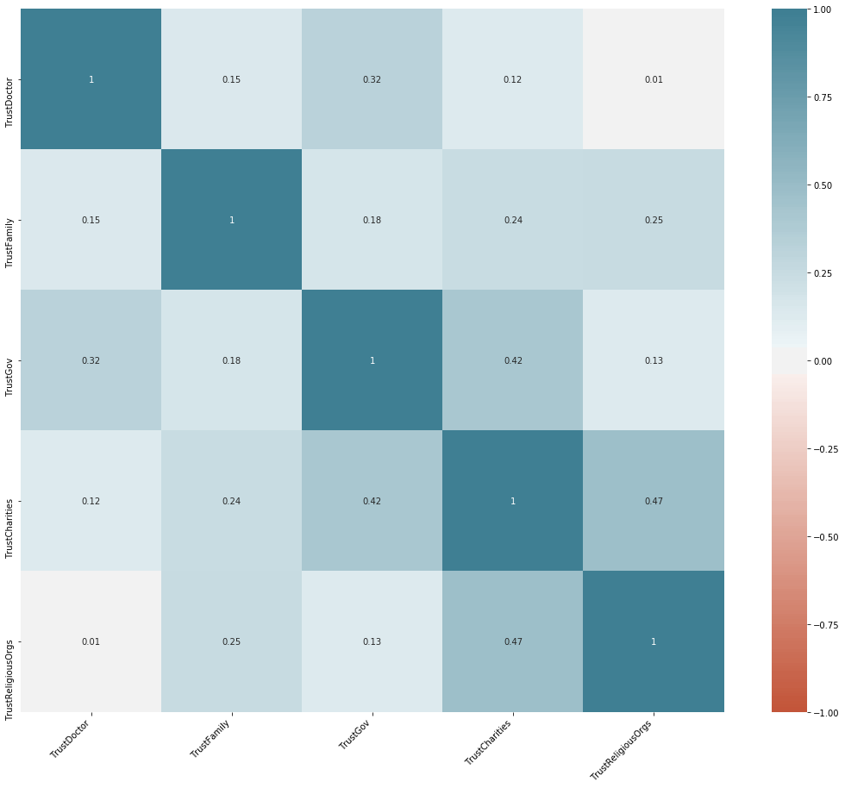
Relationship between dimensions of trust
There is a relationship between dimensions of trust itself.
People who trust charities tend to trust religious organization.
People who trust government tend to trust doctor.

Slide 16
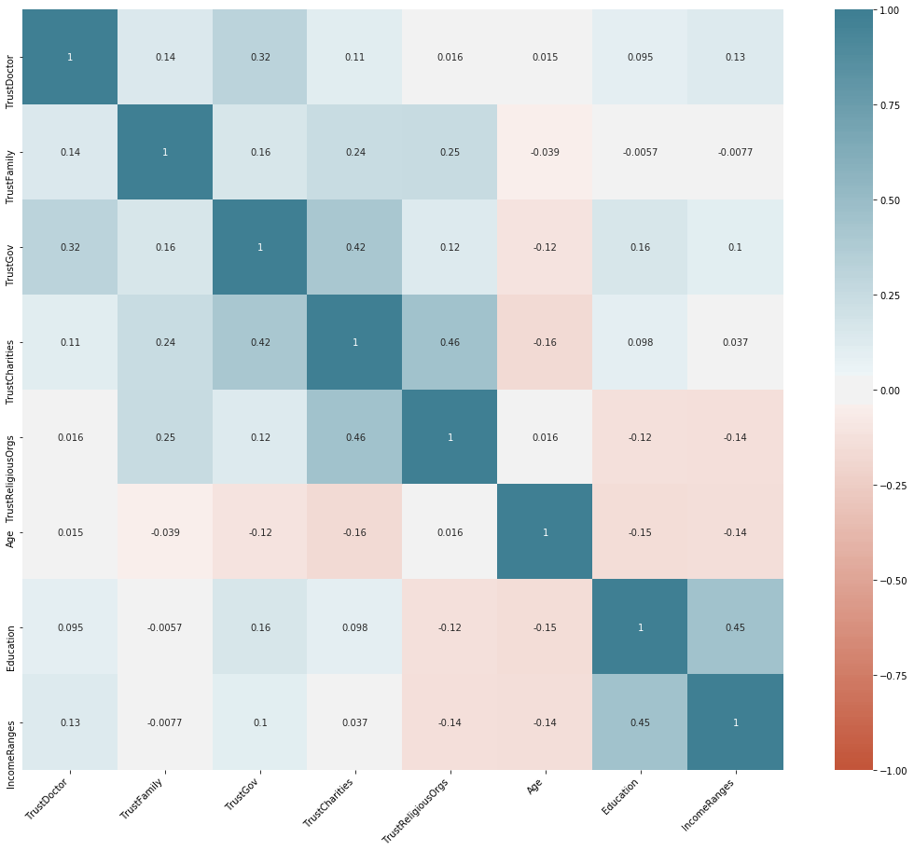
The influence of age/income/education on trust
There is a positive relationship between age, income and education with trust doctor.
People with higher education level and higher income level tend to trust government. At the same time, they tend to do not trust religious organization.

Slide 17
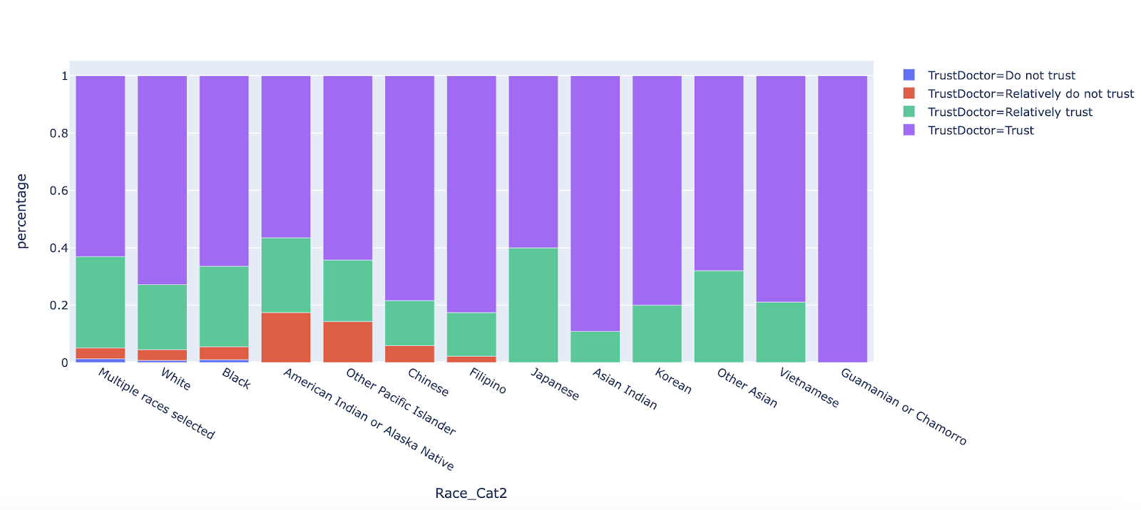
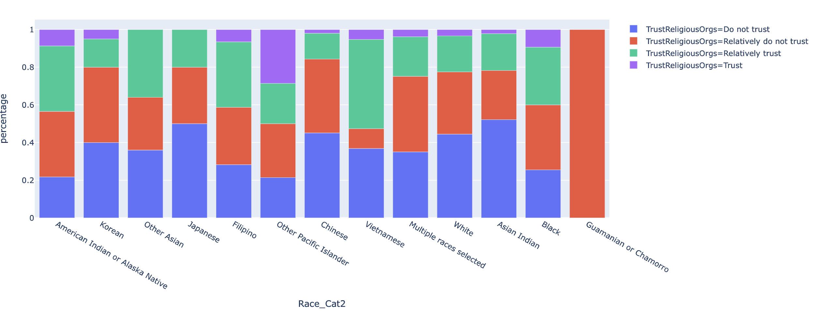
Trust level based on race

Slide 18
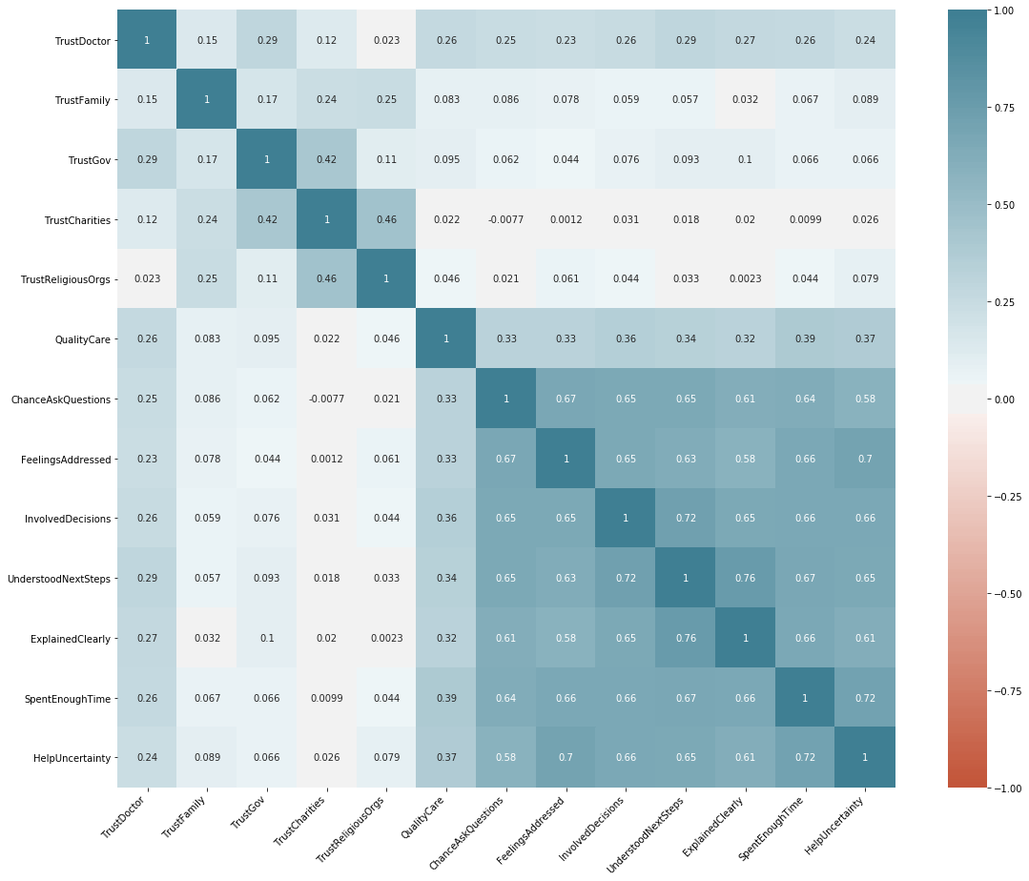
How to increase the trust level to doctor?
There is obvious relationship between the quality of healthcare and trust level to doctor.
If we want to make people trust doctor more, we should increase the quality of healthcare first.

Slide 19
Predictive Analysis
The human body is the best picture of the human soul.
-Tony Robbins

Slide 20
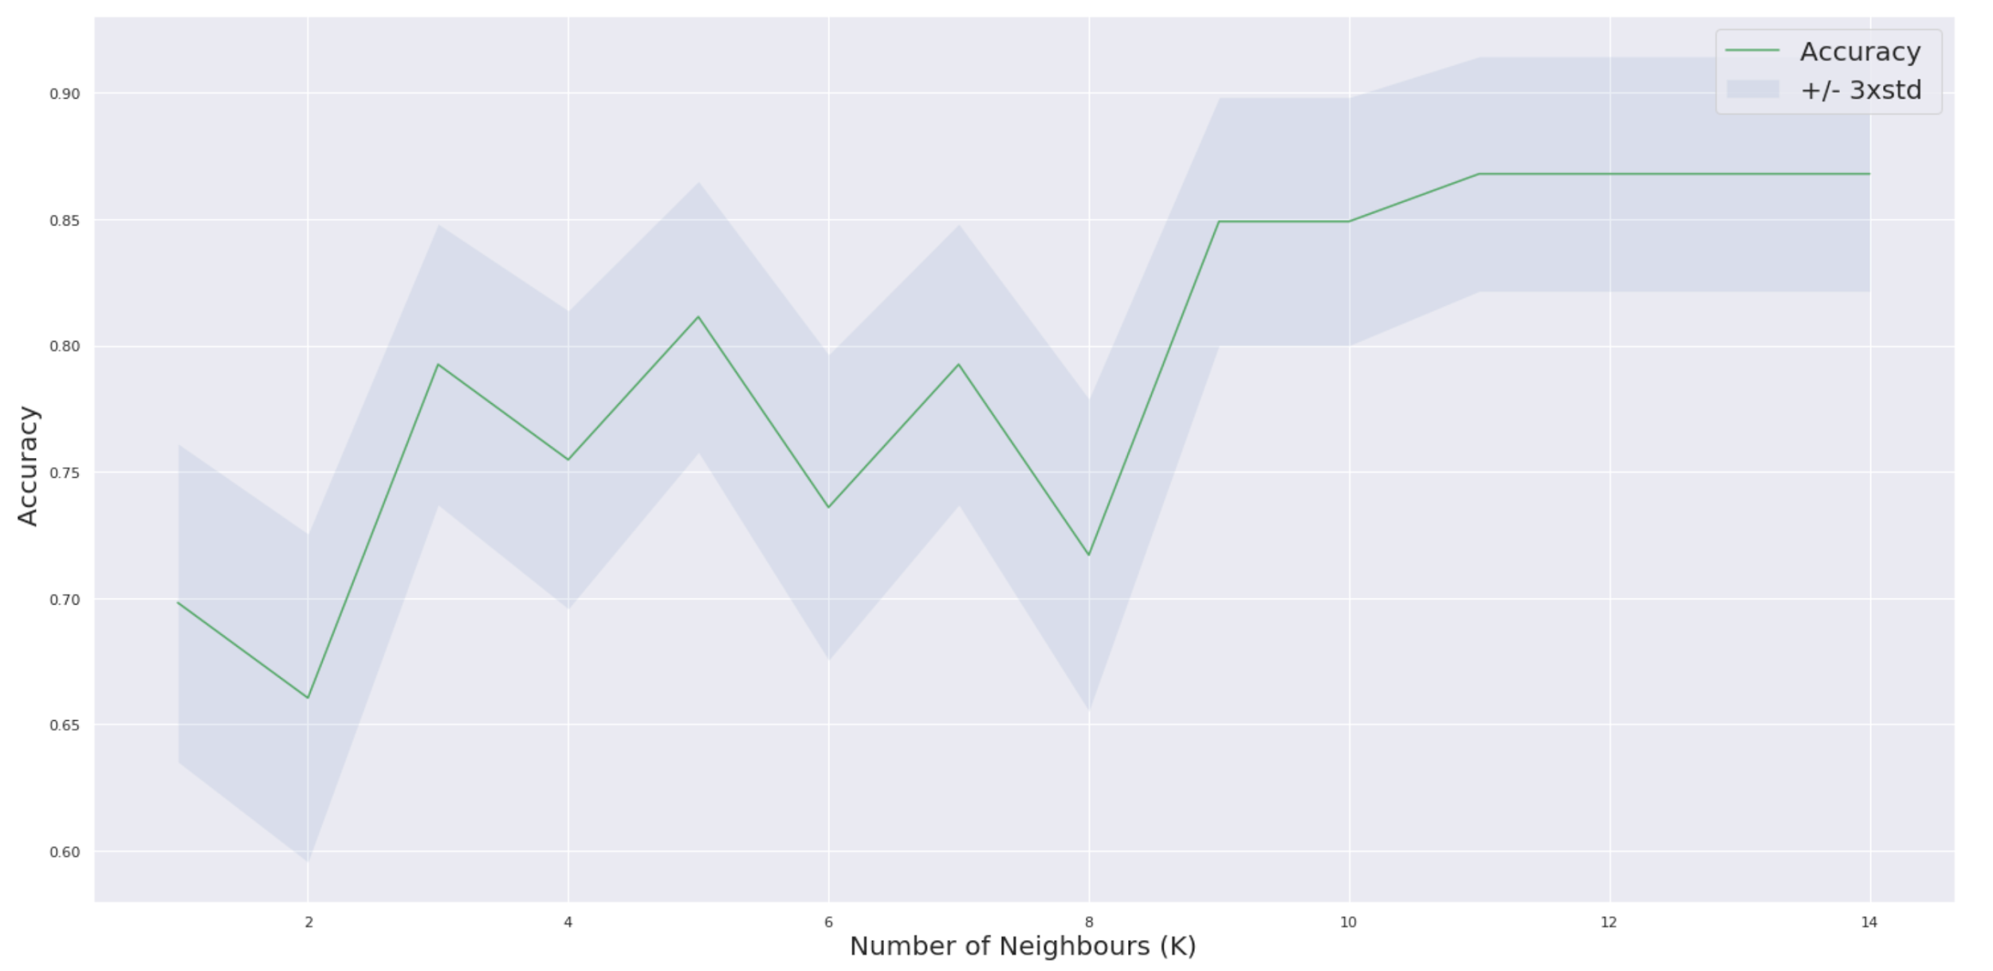
K-Nearest Neighbours
80/20 Split Train/Test
Prediction Accuracy: 79%
Optimal number of Ks is between 9 - 11

Slide 21
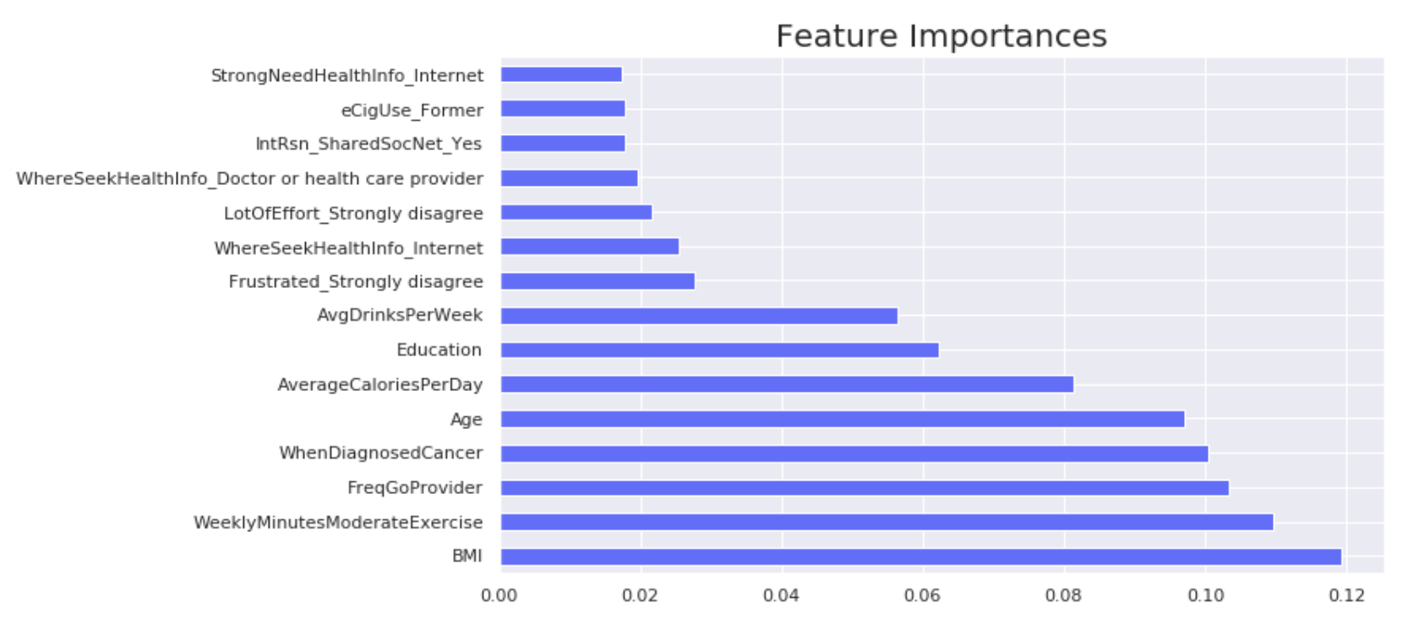
Random Forest
80/20 Split Train/Test
Prediction Accuracy: 87%
Important features includes BMI, Weekly Exercise, and Frequency to visit Doctor

Slide 22
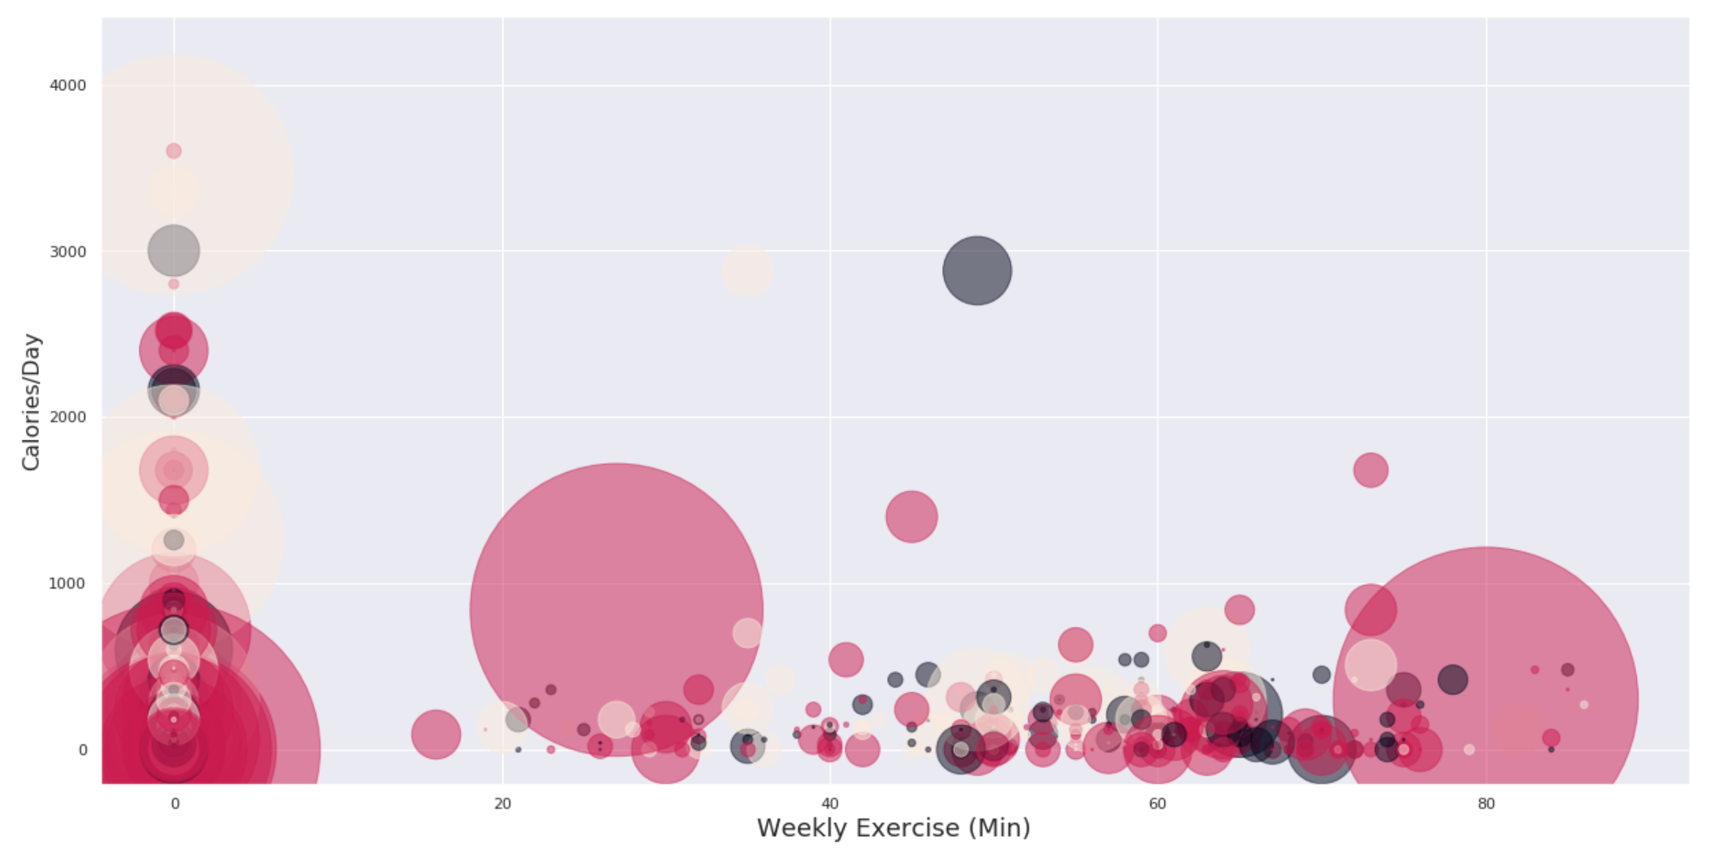
K-Means Clustering
3 cluster observed!

Slide 23
Never Google your symptoms, that is our prescription

Slide 24
Need Something?
Q
A
&
Question
Answer

Slide 25
Thank You
Team DC 20008

